Slide 1
Third-party Web APIs
Introduction | Weather API | Calling Weather API From Server
Notes:
Welcome to our lecture on third-party web APIs. In this lecture we will go through introduction, weather API, and how to call weather API from server. Let’s start the video lecture.

Slide 2

Introduction
Third-party web APIs provide access to external data (e.g., Google Maps, Instagram).
API keys identify users, limit requests, and enforce usage restrictions.
RESTful APIs use URLs with parameters and return JSON/XML data.
APIs can be called from a web server or web browser.
Notes:
APIs allow applications to communicate by providing access to external data and services. Third-party APIs offer resources like maps or social media integration. To regulate usage, an access key is often required. RESTful APIs use structured URLs to send and receive data efficiently. These APIs can be accessed from either a server or directly through a browser, making them highly versatile.

Slide 3
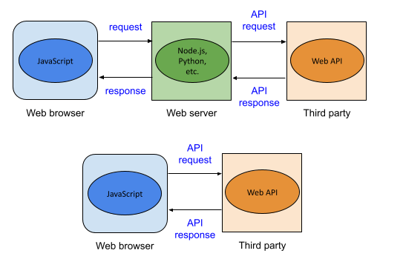
Calling third-party web API from the web browser
Notes:
When calling an external service from a browser, requests can be sent directly or through a server. A direct request from a script in the browser communicates with the external service and receives a response. Alternatively, a request can be routed through an intermediate server, which then fetches data from the external service and returns the response to the browser.

Slide 4
Weather API
OpenWeatherMap API provides current, forecast, and historical weather data.
API key required for all requests (register at openweathermap.org).
GET requests use query parameters like zip, units, and appid.
Returns weather data in JSON format by default.
Notes:
Moving forward, let's explore how external services provide weather data. A weather service allows access to current, forecast, and historical data. To use it, a unique key is required for authentication. Requests typically include parameters like location and units. The service responds in a structured format, making it easy to extract details like temperature, humidity, and conditions.

Slide 5
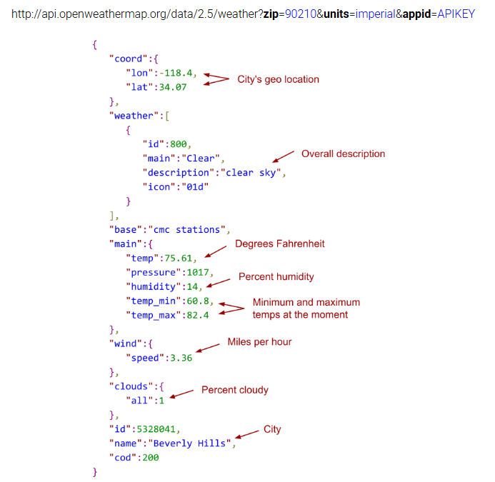
Example
Notes:
Building on the previous discussion, let's examine a real response from a weather service. The data includes geographic coordinates, temperature, humidity, wind speed, and an overall description of conditions. The response is structured, making it easy to extract key weather details. Developers use this information to display forecasts in applications or trigger weather-based actions.

Slide 6
Calling the Weather API From Web Server
node-fetch is used in Express to call the Weather API (npm install node-fetch).
URLSearchParams creates query parameters for the API request.
fetch() sends an HTTP request and returns a Promise.
then() converts JSON response to JavaScript objects for rendering.
Notes:
Continuing from the previous slide, let’s explore how a web server retrieves weather data. The server constructs a request using query parameters, sends it to an external service, and processes the response. The retrieved data is converted into a usable format for display. This method allows applications to fetch real-time weather updates efficiently for users.

Slide 7
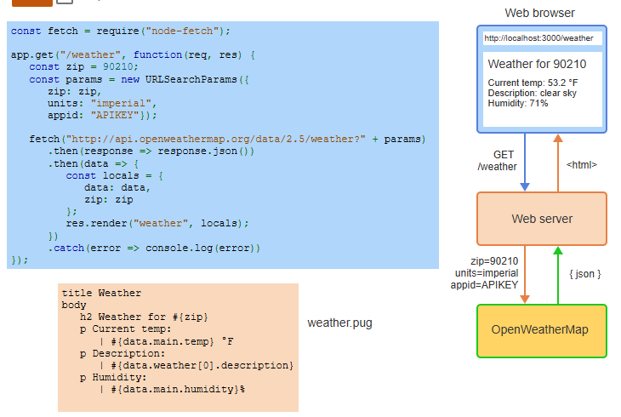
Example
Notes:
Building on the previous explanation, this example illustrates how the server retrieves weather data and presents it in a user-friendly format. The request is sent with specific parameters, the response is processed, and the data is rendered on a webpage. This approach ensures real-time updates, allowing users to access weather information dynamically through a structured workflow.

